Slide 1

DAYANANDA SAGAR COLLEGE OF ENGINEERING Department of Medical Electronics Engineering
Academic year 2024-2025
PROJECT OPEN DAY 2025
PERFORMANCE EVALUATION OF RESPIRATORY MONITORING SYSTEM
Student name | USN
RAKSHITHA PRIYA | 1DS23MD032
SAMMITA KASHYAP | 1DS23MD040
SUJANA H S | 1DS23MDO47
SWATI RAIKAR | 1DS23MD051
Under the guidance
of
Dr. N Sriraam
Head of the Department
Medical Electronics Engineering

Slide 2
INSTITUTE VISION
To impart quality technical education with a focus on research and innovation, emphasizing on development of sustainable and inclusive technology for the benefit of society
INSTITUTE MISSION
To provide an environment that enhances creativity and innovation in pursuit of excellence To nurture teamwork in order to transform individuals as responsible leaders and entrepreneurs To train the students to the changing technical scenario and make them to understand the importance of sustainable and inclusive technologies

Slide 3
DEPARTMENT VISION
To develop an excellent centre of progressive quality learning, applied & translational research through inventive collaborations and sustainable solutions to address healthcare related societal challenges
DEPARTMENT MISSION
By creating a conducive atmosphere for continuous learning through increased participation of students and faculty in various academic activities By achieving needful and relevant healthcare solutions through quality education and research By imparting education in the path of ethical and social responsibilities, to work effectively with diverse groups for the benefits of the society

Slide 4
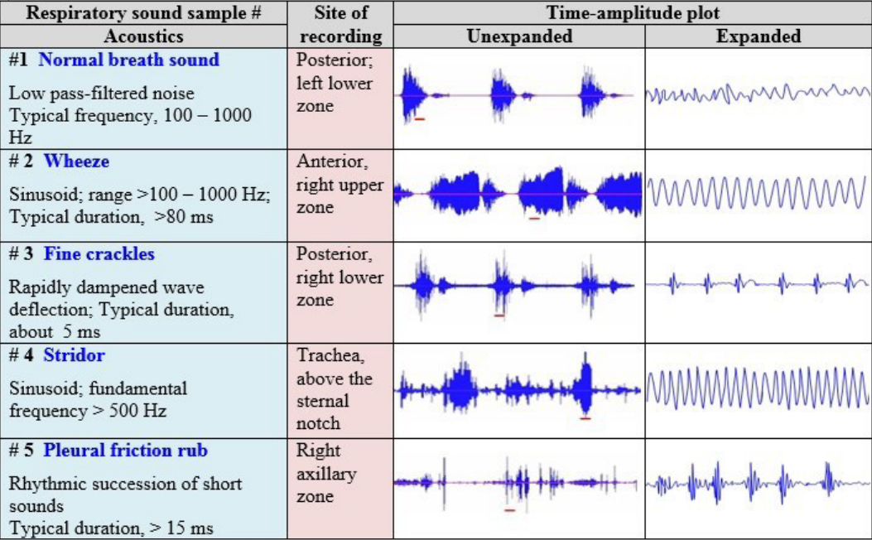
INTRODUCTION:
Respiratory signals are the measurements of the breathing rate, depth, and pattern which can be used to assess how well the body is delivering oxygen to the body's tissues and organs.
Respiratory signals helps us to analyse the breathing rate, breathing amplitude, breathing pattern and breathing difficulties.
Respiratory signals are generally measured using sensors.The raw signals collected from the sensors often come with noises like rohonchi, wheezing, stridor, crackles (rales) and pleural rub.
image 1: Different types of respiratory noise signals

Slide 5
PROBLEM DEFINITION
To find effective way to evaluate the performance of a low-cost respiratory monitoring system, comparing against Polar H10 via heart rate variability-based respiration.

Slide 6
OBJECTIVES
To collect and process respiratory signals using BME280 sensor from both nostrils and filtering and signal enhancement techniques to improve signal quality.
To develop a common algorithm for peak detection and respiratory rate estimation.
To validate the BME280 results by comparing them against:Polar H10 (heart rate derived respiratory patterns).
To assess the system's accuracy using metrics like MAE, RMSE, Precision, Recall, and correlation.

Slide 7
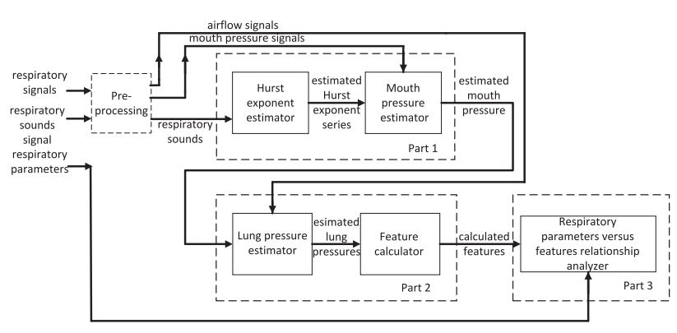
Literature Survey
SN | Author | Topic/Publication/Year | Inference
1.. | Ramon Cruz, Danilo L. Alves, Eduardo Rumenig, Renata Gonçalves, Edson Degaki, Leonardo Pasqua, Sarah Koch, Adriano E. Lima-Silva, Michael S. Koehle, Romulo Bertuzzi | Estimation of minute ventilation by heart rate for field exercise studies-Scientific Reports (Nature Publishing Group) | This paper has developed two equations (exponential and quadratic) to estimate minute ventilation from heart rate during exercise. The exponential model is recommended for both high-intensity interval and low-intensity continuous cycling. Quadratc Model :VE=141.324−2.561×HR+0.014×HR2 Exponential Model :VE=e(1.162+0.021×HR)
2.. | Esra Saatci , Ertugrul Saatci | Determination of Respiratory Parameters by Means of Hurst Exponents of the Respiratory Sounds and Stochastic Processing Methodology - IEEE Transactions on Biomedical Engineering, Vol. 68, No. 12, (December 2021)
image 3: methodology of presented paper

Slide 8
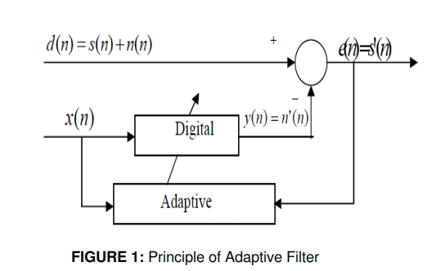
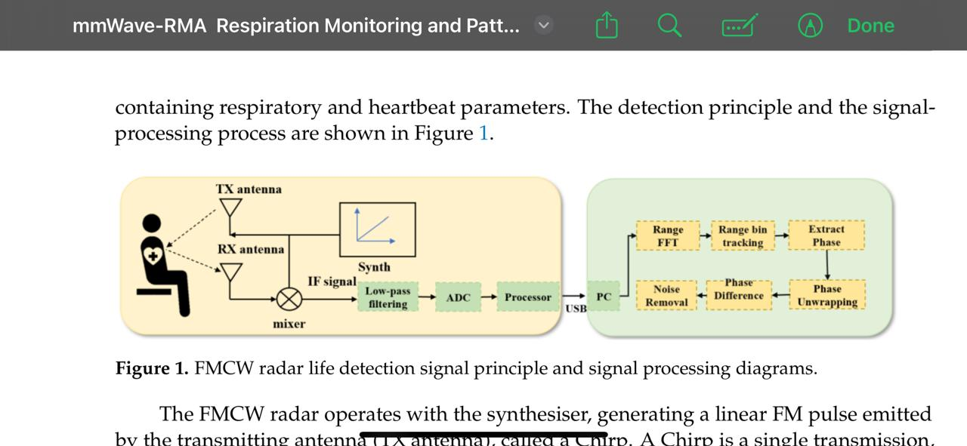
SN | Author | Topic/Publication/Year | Inference
3.. | A.Bhavani Sankar, D.Kumar, K.Seethalakshmi | Performance Study of Various Adaptive Filter Algorithms for Noise Cancellation in Respiratory Signals, Publication: SPIJ Year: 2010
5.. | Zhanjun Hao, Yue Wang, Fenfang Li, Guozhen Ding, Yifei Gao | mmWave-RM: A Respiration Monitoring and Pattern Classification System Based on mmWave Radar Publication: Sensors (MDPI) Year: 2024
image 4: principle of adaptive filter
image 5:

Slide 9
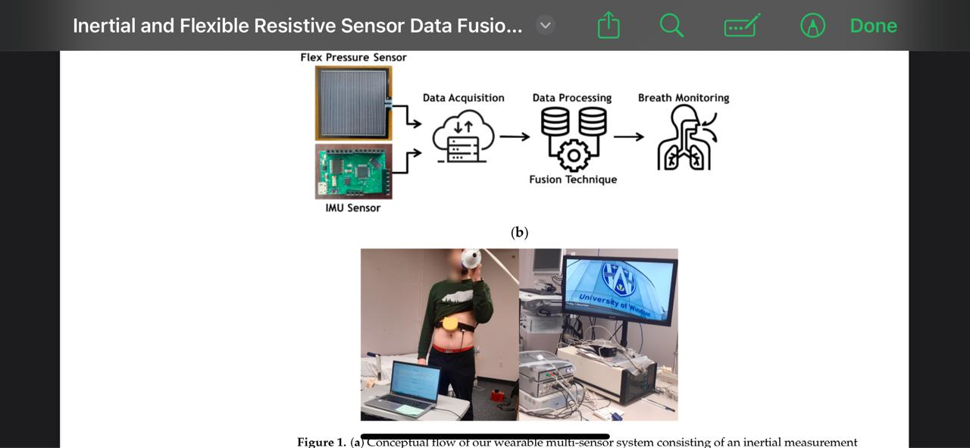
SN | Author | Topic/Publication/Year | Inference
4.. | Mehdi Zabihi, Bhawya, Parikshit Pandya, Brooke R. Shepley, Nicholas J. Lester, Syed Anees, Anthony R. Bain, Simon Rondeau-Gagné, Mohammed Jalal Ahamed | Inertial and Flexible Resistive Sensor Data Fusion for Wearable Breath Recognition Publication: Applied Sciences Year: 2024
6.. | Jessica Centracchio , Emilio Andreozzi , Daniele Esposito 1 and Gaetano D. Gargiulo | Respiratory-Induced Amplitude Modulation of Forcecardiography Signals Publication: MDPI | This paper looks at how breathing affects Forcecardiography (FCG) signals, a new way to monitor heart and lung activity. Breathing changes the strength of these signals, especially in the high-frequency component (HF-FCG), which closely follows the breathing cycle. FCG could be a useful tool for tracking both heart and lung function at the same time, but more research is needed for further conclusions.
image 6: flow of wearable multi-sensor system consisting of an (IMU) and a flexible resistive sensor connected to a DAQ module

Slide 10
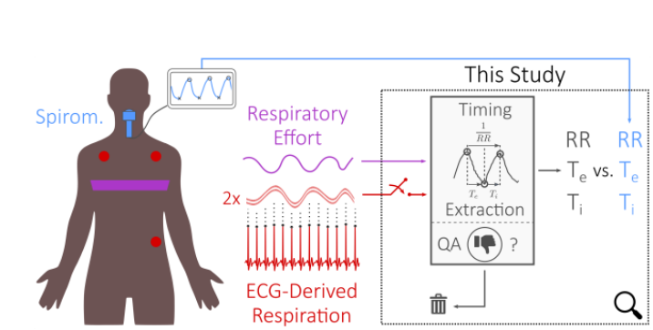
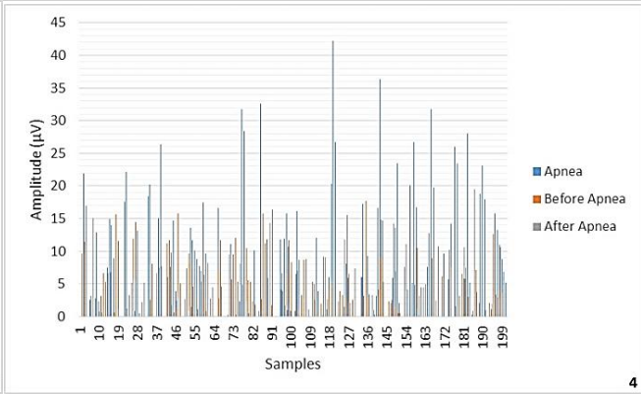
SN | Author | Topic/Publication/Year | Inference
7.. | Asim H. Gazi, Hewon Jung, Jacob P. Kimball, Omer T. Inan | Improving Respiratory Timing Estimation Using Quality Indexing and Electrocardiogram-Derived Respiration - IEEE Engineering in Medicine & Biology Society (EMBC). (July 2022)
8.. | Behrouz Moradhasel, Ali Sheikhani Oldooz Aloosh, Nader Jafarnia Dabanloo | Chin Electromyogram, an Effectual and Useful Biosignal for the Diagnosis of Obstructive Sleep Apnea" Publication: Journal of Sleep Sciences (J Sleep Sci) Year: 2021
image 7: methodology of presented paper
chart 1

Slide 11

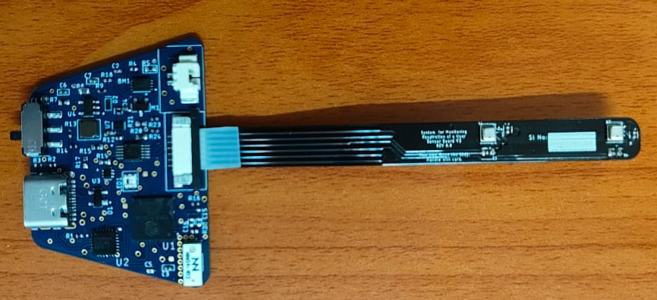


COMPONENTS
Signal processing involves software components to acquire, process, and analyze respiratory data.
Data Acquisition: seriel bluetooth terminal
Data cleaning and Signal Filtering :Using python code
Respiratory device sensor and Polar h10 DEVICE

Slide 12
Block diagram
Wearable respiratory device
(temperature,humidity,pressure)
Polar H10 device
(ECG)
Data Acquisition
Data Acquisition
Data cleaning,Data Filtering and Peak Detection
Data cleaning,Data Filtering and Peak Detection
Visualization and Comparision
Regression Model
Final Matrix Table

Slide 13
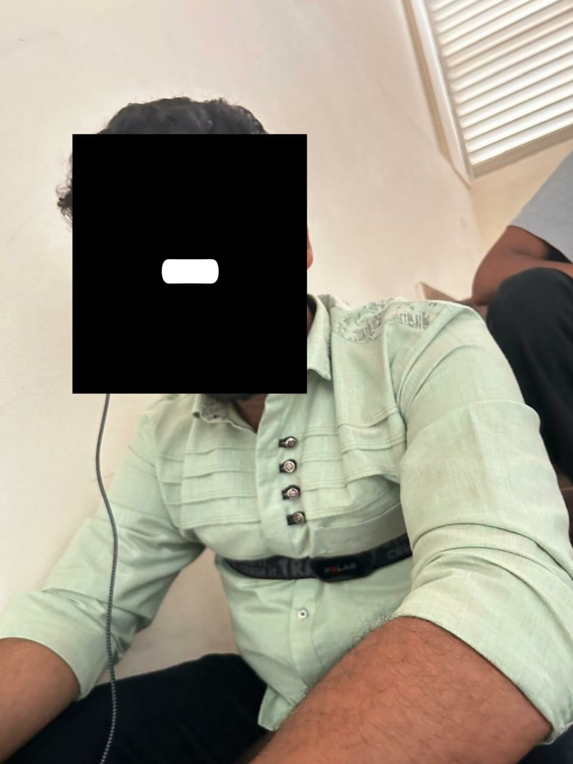
WORK DONE
Data collection
Respiratory monitor sensors (left and right nostrils)
Polar H10 (heart rate)
2. Preprocessing
Data cleaning
Apply filter
Smoothing
3. Peak detection and respiratory rate
4. Visualisation and comparison
MAE, RMSE, Bias, R^2, Mean %error, Mean %accuracy
Metric summary Table
image(1): Data Acquisition

Slide 14
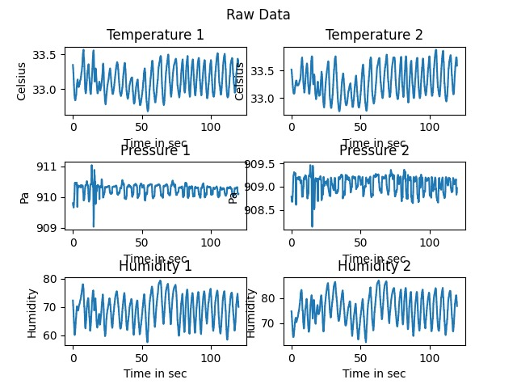
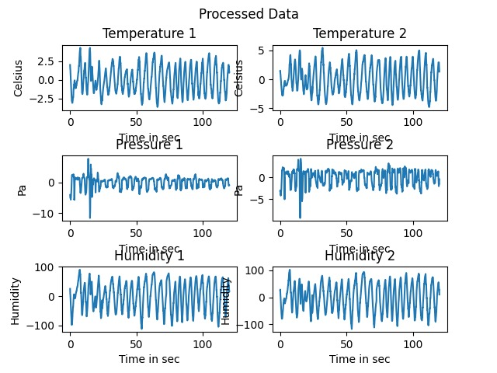
Graph(1)(2): Data from subject 1 recovery (BME280)

Slide 15
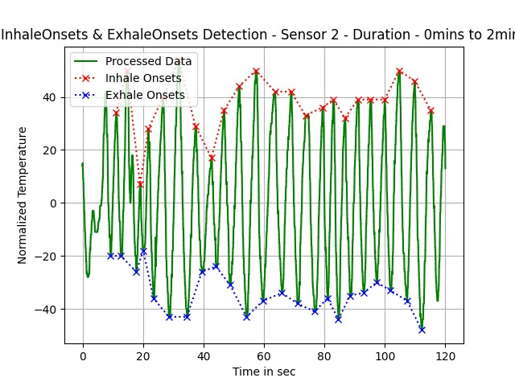
Graph(3): Subject 1 recovery

Slide 16
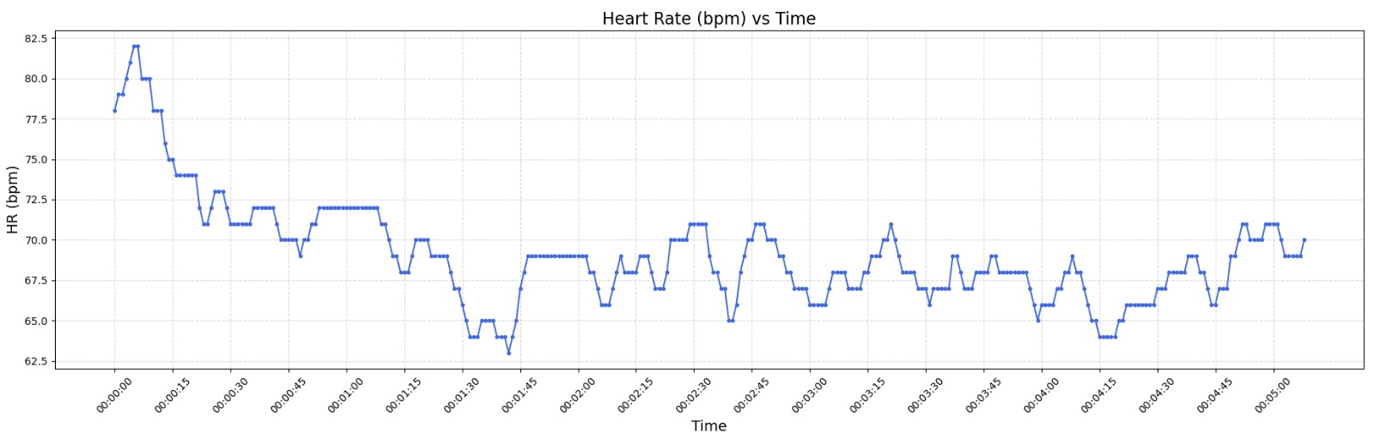
Graph(4): Subject1-recovery (Polar H10)

Slide 17
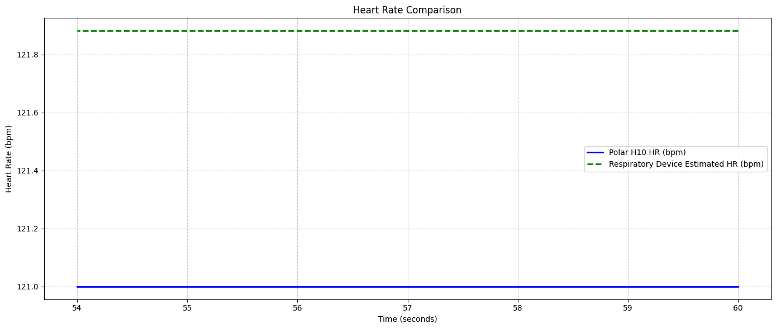
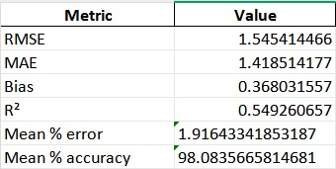
Graph(7) and Table(1): Subject4-recovery graph comparision (Polar H10 and BME280) along with metrics table

Slide 18
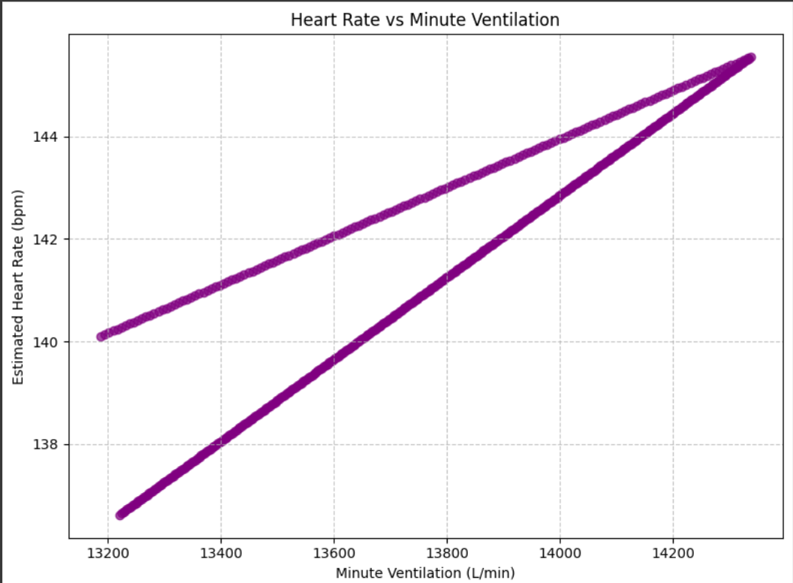
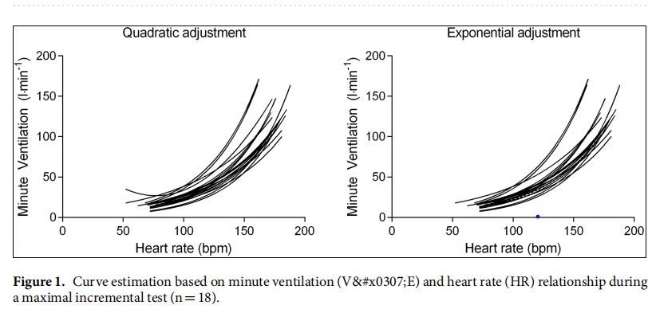
COMPARISION TO EXISTING ALGORITHMS
Properties | OUR ALGORITHM | EXISTING ALGORITHM
Equation used for Regression model | HR=a*VE+b (HR= heart rate, VE=minute ventillation) | (HR=(a+b1VE^2+b2VE^2)) (HR=exp(a+b1*VE))
Regression model style | Linear model | Quadratic and Exponential model
Heart rate vs Minute ventillation
graph(8):Estimation of minute ventilation by
heart rate for two subjects
graph(9):Estimation of minute ventilation by
heart rate for field exercise studies

Slide 19
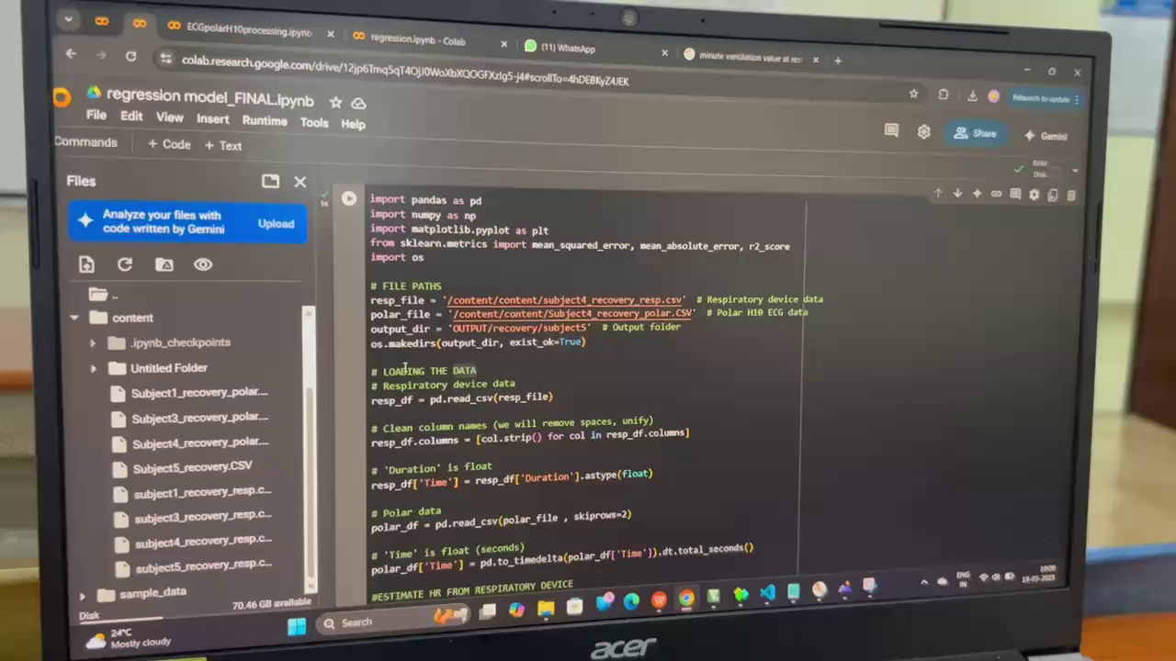
VIDEO(1): Demo video

Slide 20
RESULTS
Average form factor found to be: 5.005 \\ 4.5 being the standard
Average heart rate during rest: 87 bpm
Average heart rate during Endurance (physical activity): 124 bpm
Average heart rate during Recovery time: 95 bpm
Average endurance time: 1 min 4s
Average recovery time: 1 min 19s

Slide 21
CONCLUSION
Respiratory monitoring device BME280 shows approx 6% percentage error relative to Polar H10, making it a viable and usable device. Thus, we can say we have validated the BME280 respiratory device’s results (heart rate derived respiratory patterns).
We have developed a common algorithm for respiratory rate estimation.
We observed that the ability of a person to endure intensive physical acitvities is closely correlated to his/her BMI.

Slide 22
ALL- REFERENCES
[1]Asim H. Gazi, Hewon Jung, Jacob P. Kimball, Omer T. Inan, ‘Improving Respiratory Timing Estimation Using Quality Indexing and Electrocardiogram-Derived Respiration’ - IEEE Engineering in Medicine & Biology Society (EMBC). (July 2022)
[2] Esra Saatci , Ertugrul Saatci, ‘Determination of Respiratory Parameters by Means of Hurst Exponents of the Respiratory Sounds and Stochastic Processing Methodology’ - IEEE Transactions on Biomedical Engineering, Vol. 68, No. 12, (December 2021)

Slide 23
[3] A.Bhavani Sankar, D.Kumar, K.Seethalakshmi, ‘Performance Study of Various Adaptive Filter Algorithms for Noise Cancellation in Respiratory Signals’ , Publication: SPIJ Year: 2010
[4] Zhanjun Hao, Yue Wang, Fenfang Li, Guozhen Ding, Yifei Gao, ‘mmWave-RM: A Respiration Monitoring and Pattern Classification System Based on mmWave’ (MDPI)
Year: 2024
[5] Mehdi Zabihi, Bhawya, Parikshit Pandya, Brooke R. Shepley, Nicholas J. Lester, Syed Anees, Anthony R. Bain, Simon Rondeau-Gagné, Mohammed Jalal Ahamed, ‘Radar Publication: Sensors’ (MDPI) Year: 2024. Inertial and Flexible Resistive Sensor Data Fusion for Wearable Breath Recognition Publication: Applied Sciences Year: 2024

Slide 24
THANK YOU

